Slide 1
Sports Ball Master
Nicolas Caceda, Kamp Duong, Trevor Evans, Luis Mendez, Brandon Schultz

Slide 2
Project Summary Overview
Keep track of athletes and team stats
Managers can create teams
Managers can invite athletes to teams
Athletes can request to join Teams
Scores of games can be seen
Win and loss ratio of teams and individual athletes can be seen
Administrators can edit scores and create games
Fans can view the statistics and follow teams

Slide 3
Team Overview
Nicolas Caceda - Back-end
Kamp Duong - Lead back-end, Web designer
Trevor Evans - Documentation
Luis Mendez - UML/SQA designer, Front-end GUI
Brandon Schultz - Lead Front-end GUI
Group Effort:
Hours: ~140
LOC: 1,900 - 2,000
# of classes: 12
# of modules/libraries: 6
Java.util, Java.time, Java.io, Java.text, Java.net, JavaFX.*

Slide 4
Video
https://youtu.be/QRHUJPxBiUw

Slide 5
Legacy - Known Issues
Bug in ListViews
Does not register selection change if you select another item of the same value.
Administration Menu - edit score function will edit previous selected score.
Must sign out to see changes
Notification Box<ListView>
Null Pointer Exception occurs when list becomes empty.
When signed in as an Athlete, the last notification does not get remove permanently.
Reappears when you sign back in.
Not responsive design
Scaling the window has no effect on the application.

Slide 6
Legacy - Testing
Testing was done as individual units
The units were integrated together
People who did not work on that section of code tested for errors
As the project progressed code was slowly built
Get it to run on the console first
Get it to display on the GUI
Get it to function properly
Debug

Slide 7
Legacy - Learned, Challenges, Redo, and Suggestions
Learned
Interactions within JavaFX
Team Management
Challenges
File Structure and File Maintenance
Calendar Creation
Redo
Start using a database
Organize files inside project
Create a file manipulation class if not using a database
Suggestions
Plan first/earlier
Set aside more time
Explore more options to add/experiment with

Slide 8
Thank you; any Questions?

Slide 9
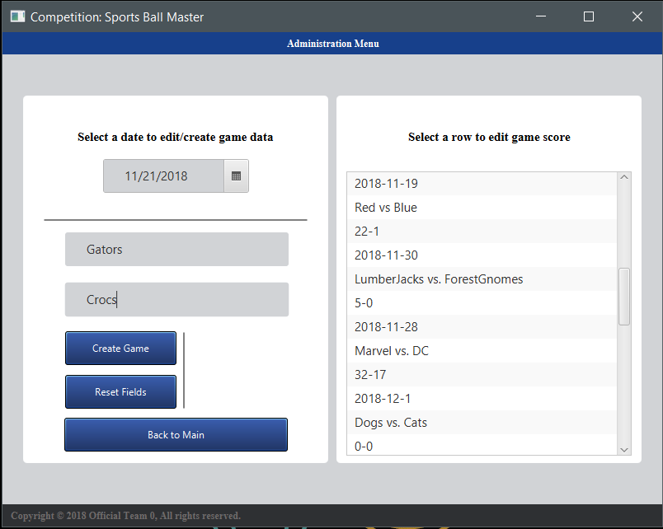
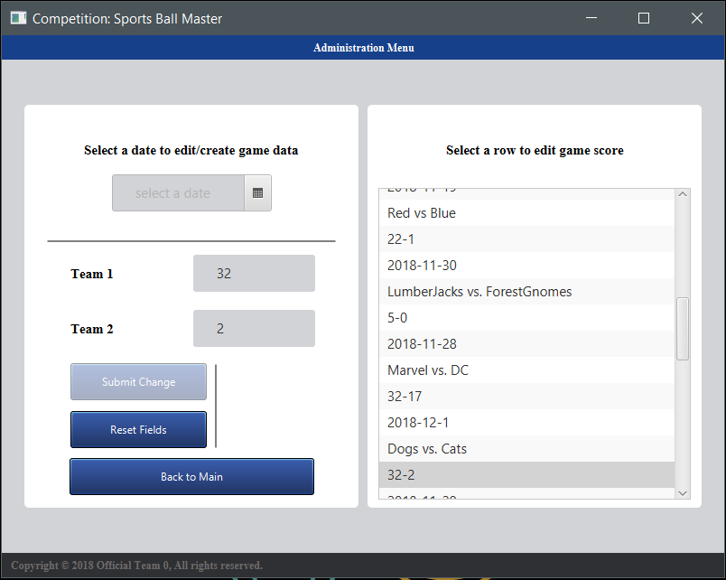
Screenshots

Slide 10
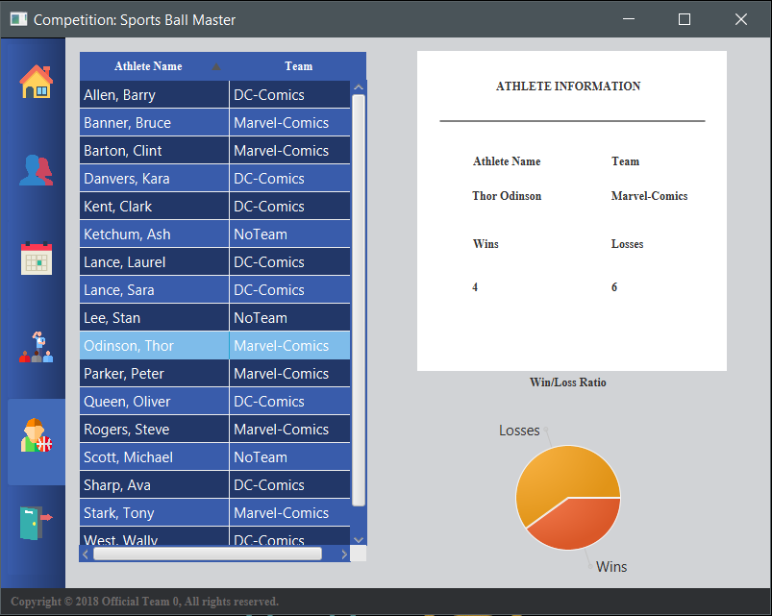
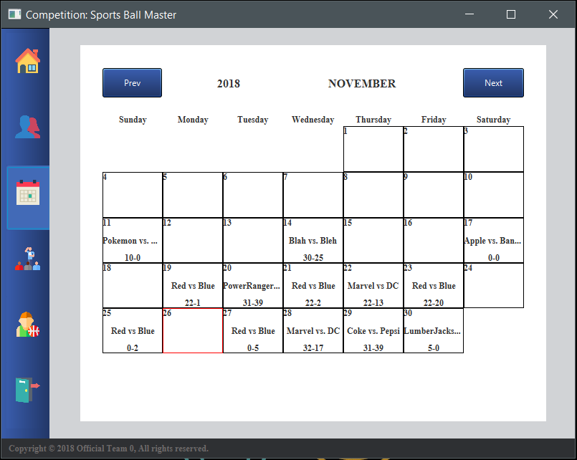
Screenshots

Slide 11
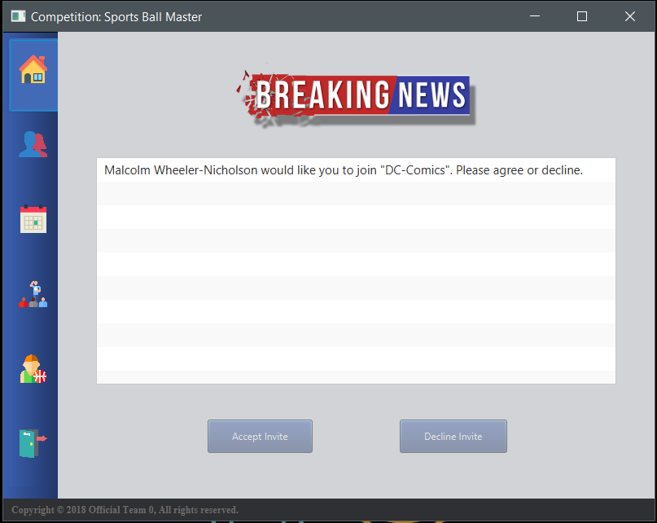
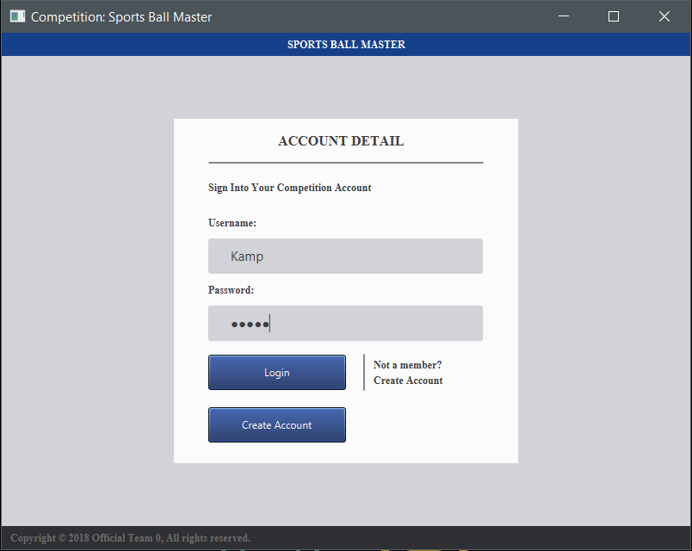
Screenshots

Slide 12
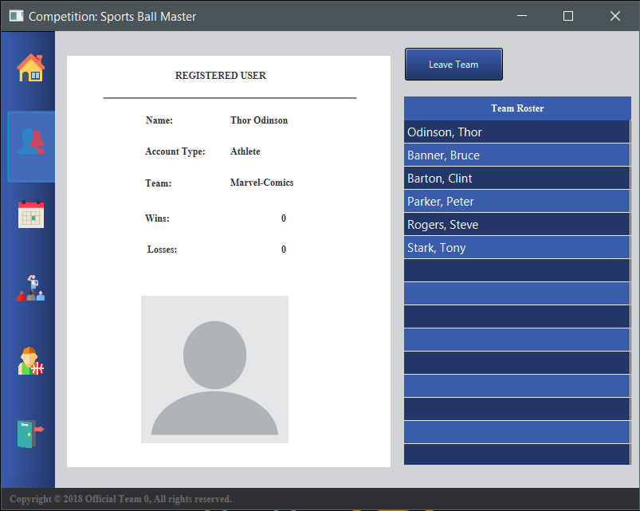
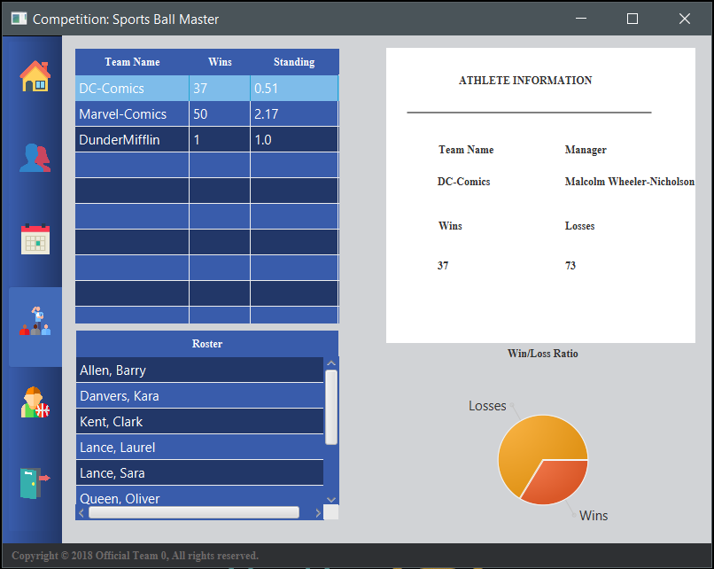
Screenshots

Slide 13
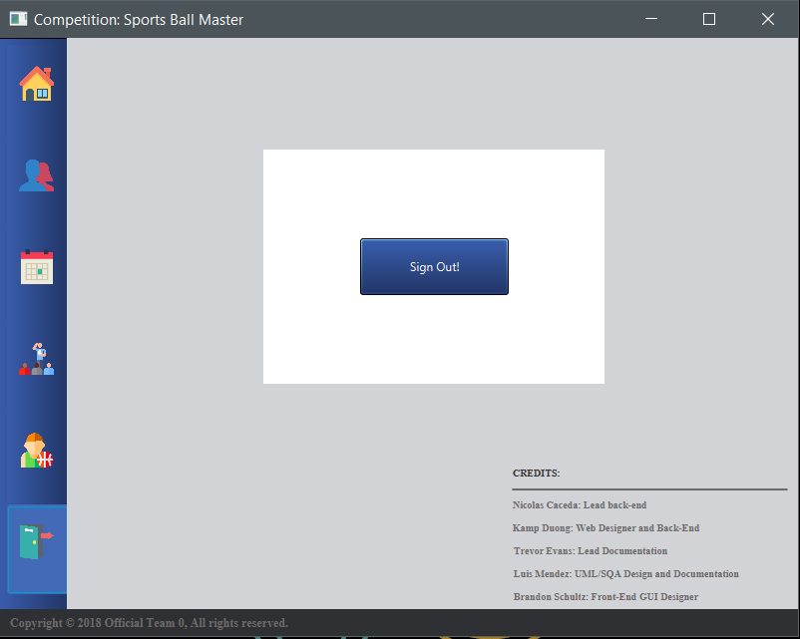
Screenshot

